Slide 1

Brindavan College of Engineering
DEPARTMENT OF COMPUTER SCIENCE AND ENGINEERING
A project presentation on
“Diabetic Foot Ulcer Detection System”
Presentation By: Batch- 06
Name USN
CHAITHANYA. M 1BO22CS013
LIKHITH. E 1BO22CS038
NITHIN. P 1BO22CS048
SHREYA. T 1BO22CS067
Under the Guidance of
Dr. Sureshu
HOD, Dept of CSE, BrCE

Slide 2
CONTENTS
Problem Statement
Literature Survey
Proposed System/ Methodology
Progress
Core Modules
Hardware and software Integration system
Model
Testing and Validation

Slide 3
PROBLEM STATEMENT
Diabetes mellitus frequently leads to chronic wounds characterized by impaired healing, prolonged inflammation, poor vascularization, and increased susceptibility to infection.
These wounds, often occurring in the lower limbs as diabetic foot ulcers, pose major medical, social, and economic burdens. Existing wound care approaches are often inadequate due to the complex pathophysiology involving hyperglycemia, vascular dysfunction, neuropathy, compromised immune response, and frequent recurrence or chronicity.
There is a critical need for comprehensive solutions that improve early detection, monitoring, and treatment of diabetic chronic wounds to reduce complication rates, prevent amputations, and enhance quality of life for affected individuals.
The D-AID project aims to develop an integrated system/application that supports the effective management and treatment of diabetic chronic wounds by employing advanced monitoring, intelligent assessment, and personalized intervention strategies, ultimately improving clinical outcomes for diabetic patients suffering from chronic wound conditions.

Slide 4
LITERATURE SURVEY
Year | Authors | Title | Methodology | Advantages | Disadvantages
2022 | G. Merlin Sheeba; Y. Bevish Jinila | Performance evaluation of wearable IoT enabled network for rural health monitoring | Wearable Internet of Things (IoT)–enabled biosensors are attaining endless interest day by day. The growing healthcare demand and consciousness in elderly people has become one of the important aspects. | Provides real time monitoring, ensures patient data privacy, and prevents unauthorized access through encryption. | Rural environments often present physical and environmental challenges such as poor weather conditions, lack of electricity, or obstructive terrain, which can interfere with device performance and connectivity.
2014 | M. Ochoa, R. Rahimi and B. Ziaie | Flexible sensors for chronic wound management | Chronic non-healing wounds are a major source of morbidity and mortality in bed-ridden and diabetic patients. Monitoring of physical and chemical parameters important in wound healing and remodeling process can be of immense benefit for optimum management of such lesions | These sensors enable early detection of infections or delayed healing, which can significantly reduce complications and healthcare costs | Interpretation of the sensor data may require specialized knowledge or clinical algorithms, which might not yet be standardized, potentially affecting the consistency and reliability of clinical decisions based on sensor outputs.

Slide 5
LITERATURE SURVEY
Year | Authors | Title | Methodology | Advantages | Disadvantages
2022 | M. A. Kafi, A. Paul, A. Vilouras, E. S. Hosseini and R. S. Dahiya | Flexible biosensor diabetic wound | Chronic wounds present a serious health burden and are a source of staggering health care costs in developed countries. These numbers will certainly increase in the coming decades with the aging population and the increase in the prevalence of diabetes mellitus and its associated cutaneous ulcers | The integration of flexible biosensors with wireless communication systems allows for remote health monitoring, which is particularly valuable for diabetic patients who require long-term care and frequent wound assessments | Interpreting biosensor data may require advanced algorithms or clinical expertise, and currently, there is a lack of standardization in how this information is used in wound management protocols. Lastly, long-term biocompatibility and potential immune reactions remain concerns that need thorough investigation before clinical application.

Slide 6
METHODOLOGY
Automated Wound Assessment: The system utilizes artificial intelligence, particularly computer vision and machine learning, to automatically detect and evaluate wound characteristics. This helps diagnose wound severity and track progression objectively, reducing dependence on human expertise.
Remote Monitoring: Patients can regularly upload images or sensor data from home, enabling automated and clinician-supervised tracking without frequent hospital visits. Telemedicine integration allows healthcare providers to intervene quickly in case of potential complications or non-healing wounds.
Personalized Treatment Guidance: Based on wound type, size, stage, and patient’s individual health data, the system offers tailored care recommendations (e.g. dressing changes, offloading advice, hygiene instructions, alerts for infection risk). AI can assist with dynamic treatment plan adjustments as healing progresses.
Data-Driven Alerts : Patients are provided with alerts if their wound condition worsens or if compliance drops. The system includes educational modules to empower patients with knowledge for proper wound care and risk reduction.

Slide 7
PROPOSED SYSTEM
PROPOSED SYSTEM
The proposed smart bandage system represents the next generation in wound care — a fully integrated, real-time, intelligent wound management platform.
Components of the Proposed System
Flexible, biocompatible substrate: Soft, stretchable materials that conform to the skin and degrade safely over time.
Multi-functional sensors: Embedded to monitor:
  pH (infection indicator)
  Temperature (inflammation marker)
  Moisture levels (hydration status)
  Glucose levels (for diabetic management)

Slide 8
PROPOSED SYSTEM
Microcontroller & wireless communication module:
Transmits data to healthcare apps or cloud platforms.
Supports real-time alerts and telemedicine integration.
Benefits for Diabetic Patients
Improved healing rates through personalized care
Reduced hospitalizations due to early intervention.
Enhanced quality of life via reduced pain, discomfort, and stress.
Prevention of amputations and other severe complications.

Slide 9
PROGRESS
PROGRESS IN THE PHASE
System Architecture and Prototypes.
Data Collection and Annotation
Algorithm Development
System Validation
Support Modules
Documentation
Including these items will show comprehensive progress in technical development, user engagement, and practical validation, providing a strong foundation for Phase III and final deployment.

Slide 10
CORE MODULES
CORE MODULES
Wound Imaging and Data Acquisition Module
Tools to capture wound images (using mobile or web devices), record vital signs, and accept sensor data relevant to wound health and healing progress.
AI-Based Wound Analysis Module
Deep learning algorithms for automated wound segmentation, classification (infection, ischemia, healing stage), and measurement of wound size, tissue composition, and color changes.
Remote Monitoring and Progress Tracking Module
Periodic uploads of wound data/images, comparison with baseline and previous records, generation of progress charts, and detection of deviations or delayed healing.
Alert and Risk Prediction Module
Intelligent notification system for patients and clinicians in case of infection risk, worsening wound, or non-healing concerns, supported by predictive analytics.

Slide 11
CORE MODULES
CORE MODULES
Treatment Recommendation and Compliance Module
Delivery of dynamic, personalized treatment protocols based on AI analysis, reminders for wound dressing changes, medication schedules, and patient adherence tracking.
Reporting and Analytics Module
Generation of clinical reports, statistical analyses of population healing outcomes, and export functionality for further medical review and quality assurance.

Slide 12
SYSTEM REQUIREMENTS
1. HARDWARE REQUIREMENTS
a. Sensors
pH Sensor: Detects infection or bacterial activity.
Temperature Sensor: Monitors inflammation and infection risk.
Moisture Sensor: Tracks hydration levels of the wound bed.
Glucose Sensor: For monitoring local glucose levels in diabetic patients.
b. Microcontroller Unit (MCU)
Low-power processor to control sensors and data processing.
c. Power Source
Thin-film battery or bioenergy harvester (e.g., body heat or glucose-powered).
d. Wireless Communication Module
Bluetooth Low Energy (BLE) or Wi-Fi for transmitting data to a mobile device or cloud server.

Slide 13
SYSTEM REQUIREMENTS
e. Drug Delivery System (optional)
Microfluidic components or hydrogel with embedded therapeutic agents.
Electrically controlled release mechanisms.
f. Substrate Material
Biocompatible, flexible, breathable, and stretchable material (e.g., hydrogel, silicone, or biodegradable polymers).

Slide 14
SYSTEM REQUIREMENTS
SOFTWARE REQUIREMENTS
a. Firmware
Embedded code on the microcontroller to manage sensor data acquisition and communication protocols.
b. Mobile Application
Real-time display of wound conditions (pH, moisture, etc.).
Alert system for abnormalities.
Remote access for doctors and caregivers.
c. Data Storage & Cloud Integration
Secure storage of patient wound data for long-term monitoring.
Data analytics for healing trends and predictions.
d. Machine Learning
Predictive models for wound healing progress or infection detection.

Slide 15
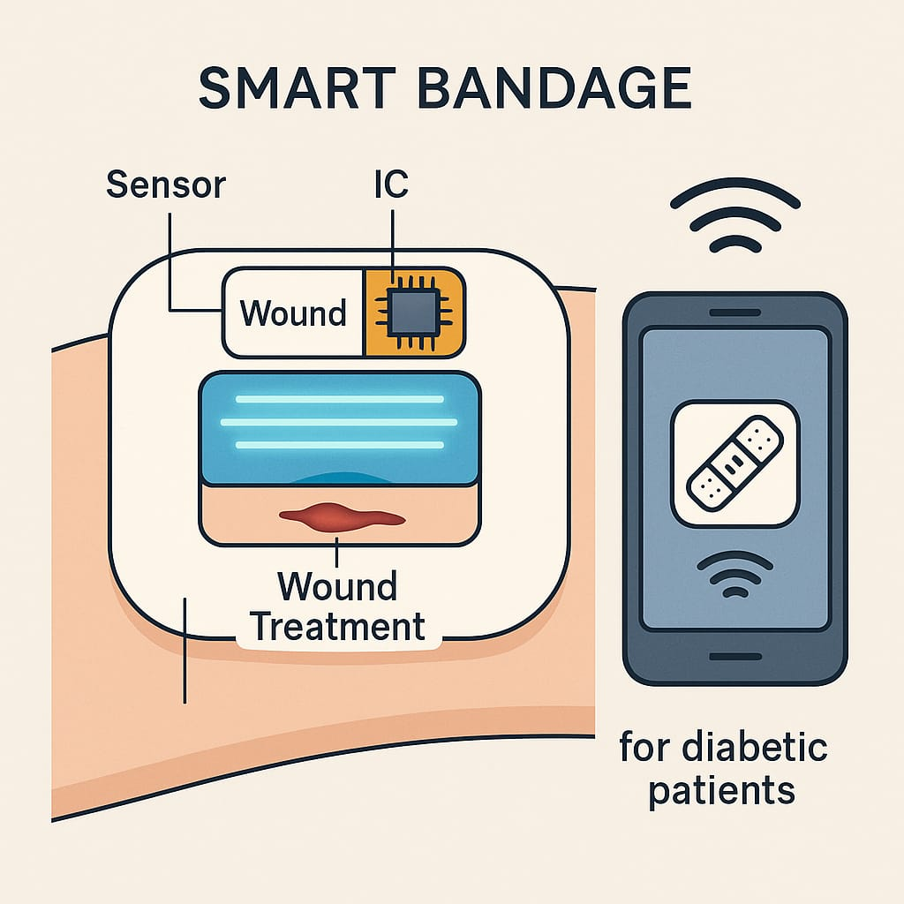
SYSTEM DESIGN/ MODEL
SYSTEM DESIGN:

Slide 16
TESTING AND VALIDATION
Performance Metrics for AI Models
Use metrics like accuracy, sensitivity (recall), specificity, precision, F1-score, false positive rate, and Matthews correlation coefficient to quantitatively assess AI model performance in wound detection, classification, and segmentation.
Clinical Validation
Conduct clinical trials or pilot studies with diabetic patients to compare AI-based wound assessment outputs against expert clinician assessments. This includes wound area measurements, classification of wound severity, infection detection, and healing progress tracking.
Technical Validation
Test image acquisition under different conditions to verify robustness and generalizability of the AI algorithms.

Slide 17
TESTING AND VALIDATION
Predictive Validation
Validate predictive models for wound prognosis to ensure they correctly identify wounds at risk of infection, deterioration, or delayed healing, enabling timely intervention.
Comparative Studies
Compare the AI-enabled system performance with traditional manual or semi-automated wound assessment methods to demonstrate improvements and advantages
Continuous Monitoring in Real-World Use
Implement remote monitoring pilots where patients upload wound data over time, assessing system consistency and early detection capabilities in ongoing care.

Slide 18
WORK PLAN AHEAD
Algorithm Optimization and Enhancement
Prototype Development and Feature Expansion
Data Collection and Annotation
Pilot Testing and Usability Studies
Integration with Healthcare Systems
Compliance and Regulatory Preparations
Scalability and Deployment Planning

Slide 19
CONCLUSION
The D-AID project presents an innovative approach to address the critical challenge of diabetic chronic wounds through the development of an AI-enabled system that enhances wound assessment, monitoring, and individualized treatment.
By leveraging advanced deep learning models and integrating remote monitoring along with clinician-patient interfaces, the platform aims to provide accurate, objective, and scalable wound evaluation, allowing for early detection of complications and optimized healing outcomes.
This digital solution not only improves clinical decision-making but also empowers patients in self-management, ultimately aiming to reduce complications such as infections and amputations, thereby improving the overall quality of life for diabetic patients.

